Slide 1
Adaptations in birds
by
MEHAK RAFIQ

Slide 2
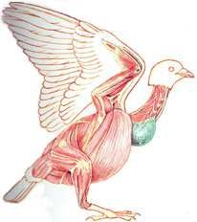
Light but Powerful Musculature
Most birds have approximately 175 different muscles, mainly controlling the wings, skin, and legs.
The largest muscles control the wings and run between the upper arm and the keel.
The pectoralis major provides the powerful downstrokeThe supracoracoideus muscle raises the wing Uses a pulley-like system to lift the wing.
These musclesconstitute about 20 – 25 percent of the bird's total body mass.
Pectoralismajor
Pulls the wing down

Slide 3
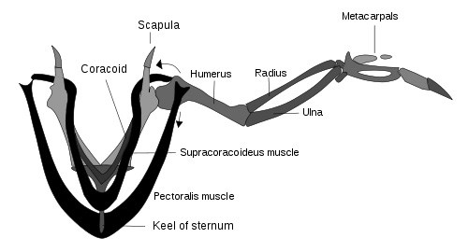
Respiratory System
Due to the high metabolic rate required for flight, birds have a high oxygen demand Birds ventilate their lungs by means of air sacs.
The active phase of respiration in birds is exhalation, requiring muscular contraction.Air flows through the air sac system and lungs.
The active phase of respiration in birds is exhalation, requiring muscular contraction.Air flows through the air sac system and lungs.
The partial pressure of oxygen in a bird's lungs is the same as the environment
Birds have more efficient gas-exchange of both oxygen and carbon dioxide than do mammals.

Slide 4
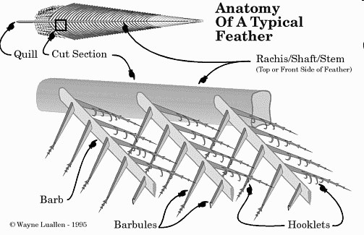
Feathers
the organisms on earth, only birds have feathers
They are instrumental in flying.
They play a critical role in temperature regulation.
Their color patterns are essential in both display and camouflage.
The mass of feathers on a bird’s body constitutes its plumage
Feathers clump in distinct tracts with featherless areas in between
Birds’ color patterns are built of these units Worn feathers are periodically replaced through a process called “molt”

